Slide 1
DECISION TABLE
Milind Parab

Slide 2
TYPES of DECISION TABLE.
UPDATES VALUES (FIXED VALUES, VARIABLE VALUES)
RETURN VALUES (WHAT IF ANALYSIS)
EG.
1. Fixed Values : Last Name.
2. Variable Values : Change of Address.
3. Return Value: Bonus amount.
_SYS_REPO requires Select, Execute, and Update Previleges.

Slide 3
Requirement.
Wherever there is a black color, change the sales to 99.

Slide 4
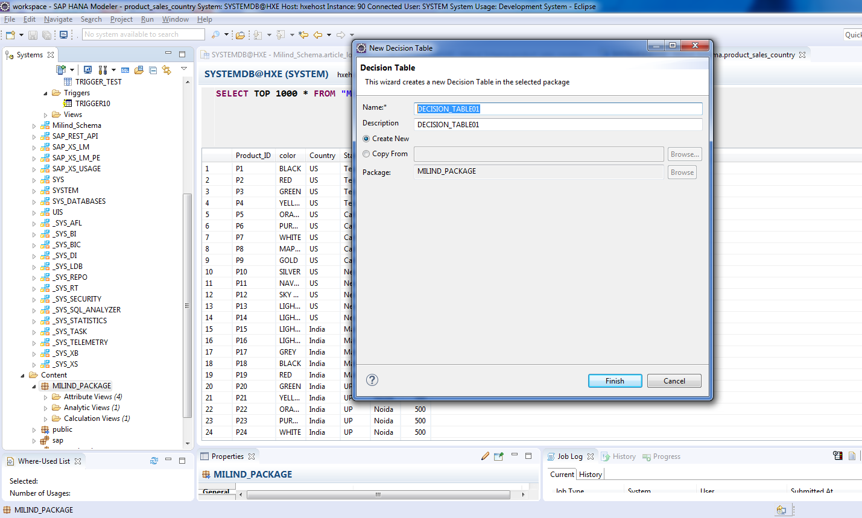
Create a decision table.

Slide 5
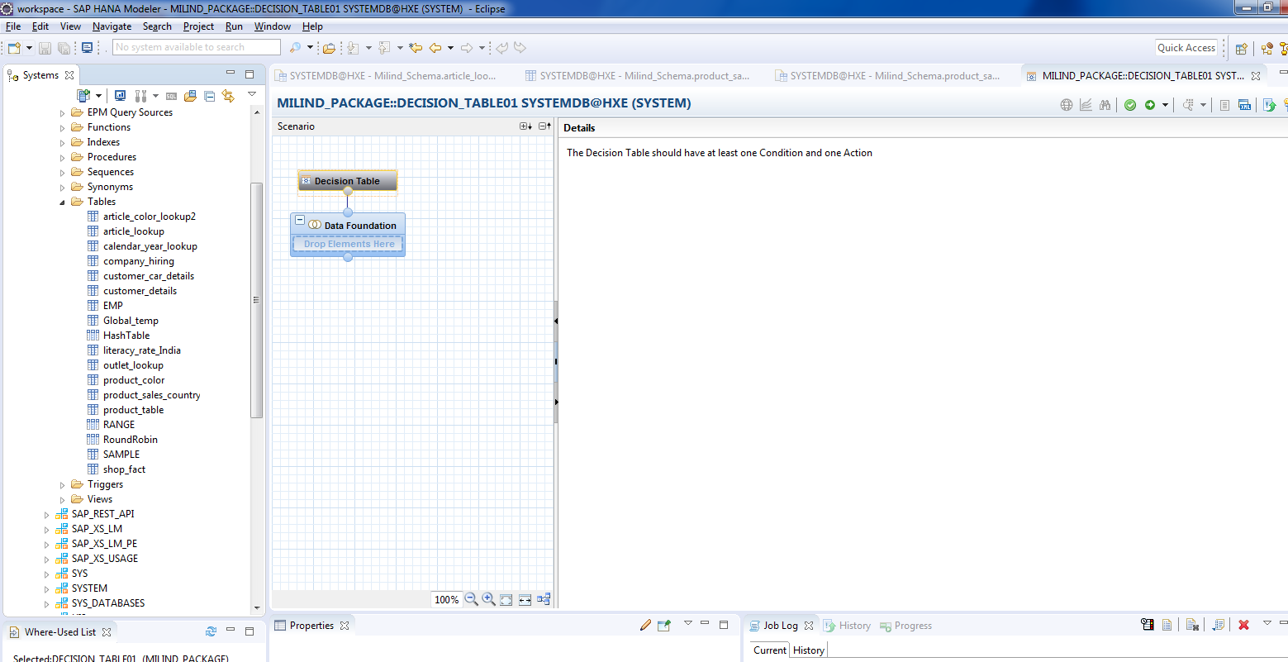
Cont.

Slide 6
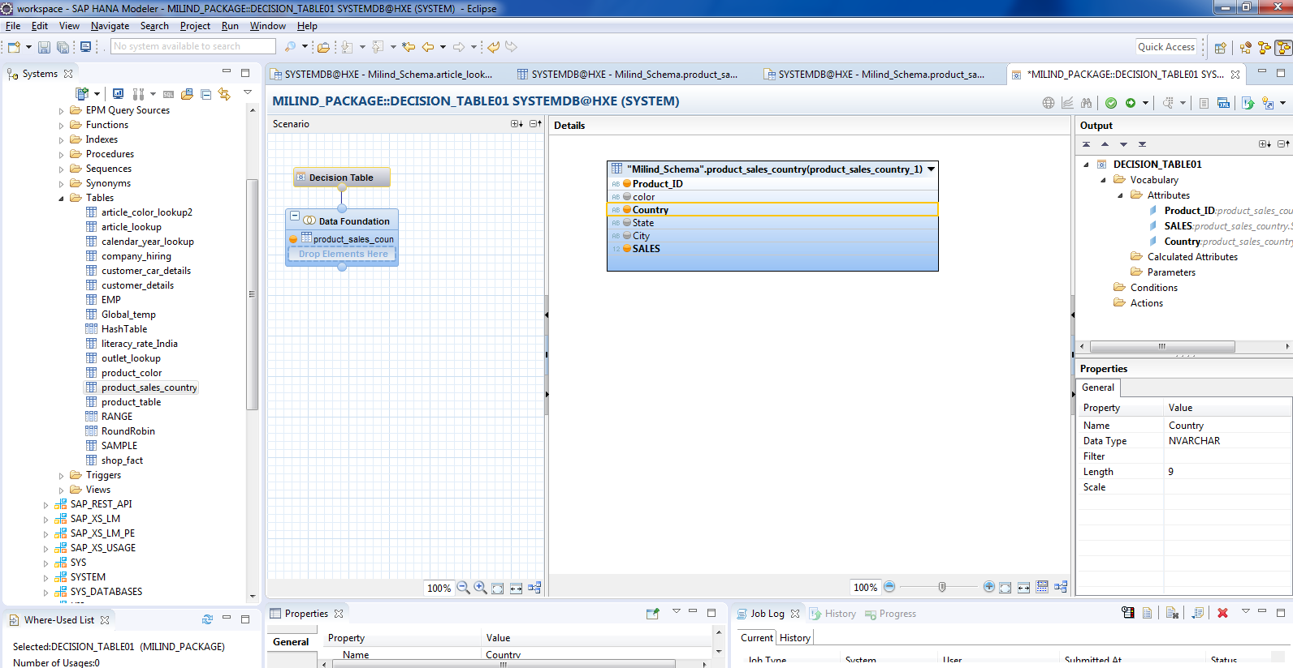
Drag and Drop the table.

Slide 7
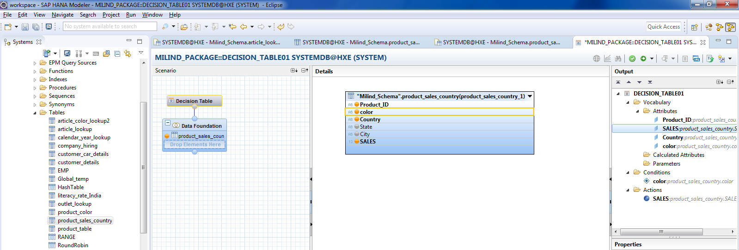
Add Color as a Condition and Sales as an Action.

Slide 8
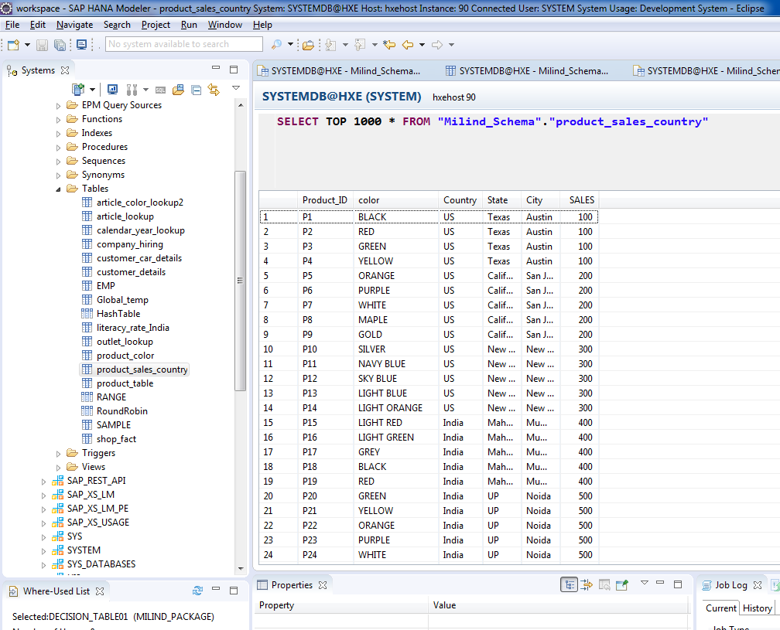
Cont.

Slide 9
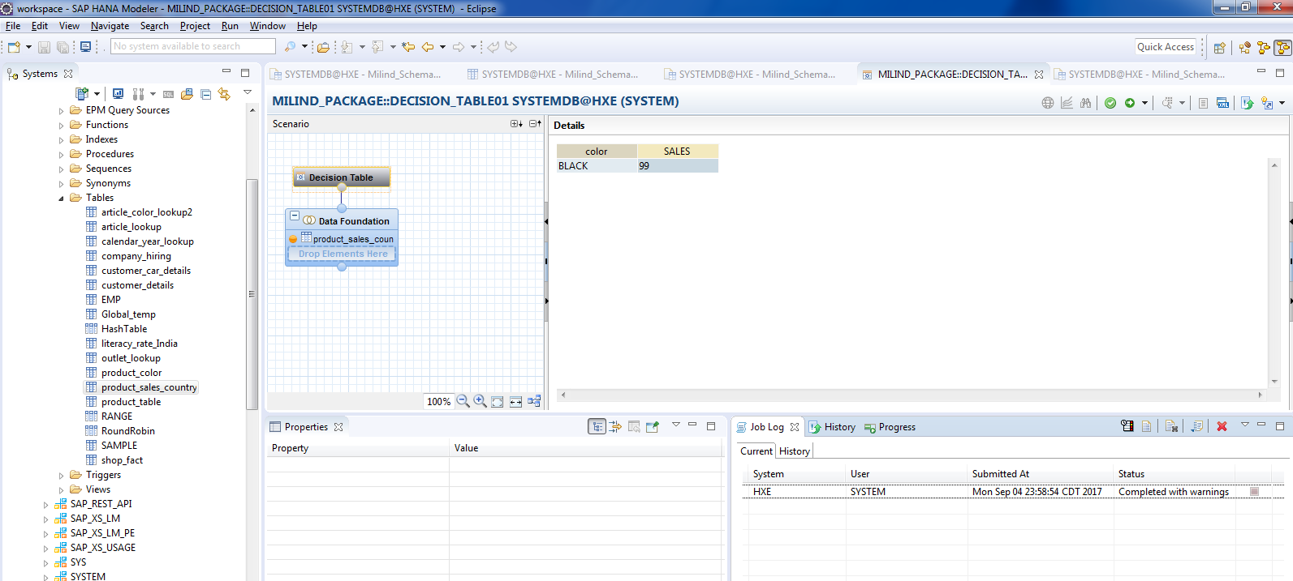
Validate and Execute.

Slide 10
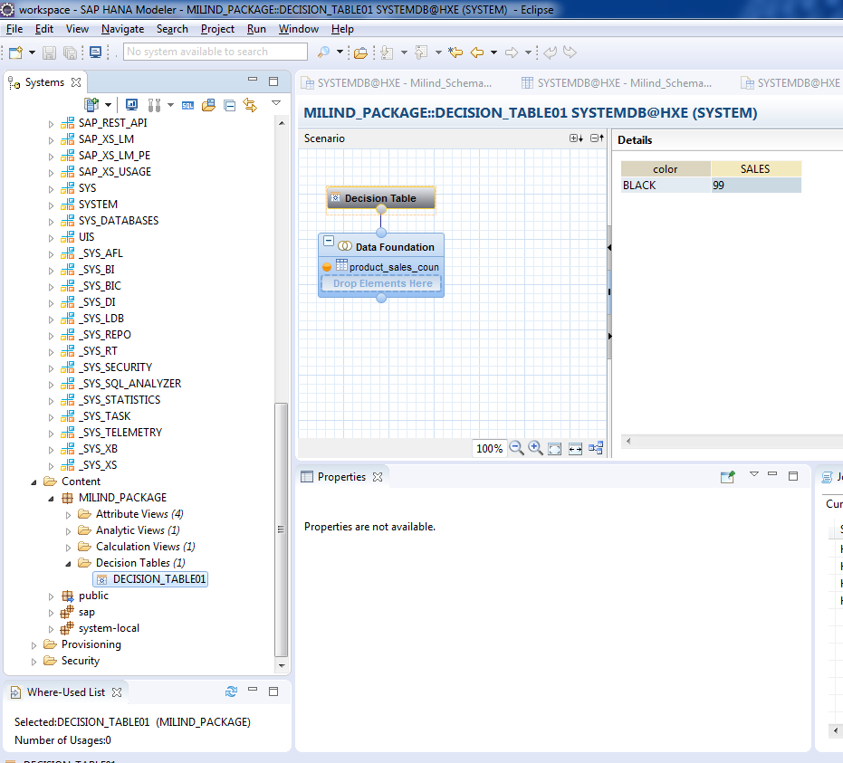
Decision table has been created.

Slide 11
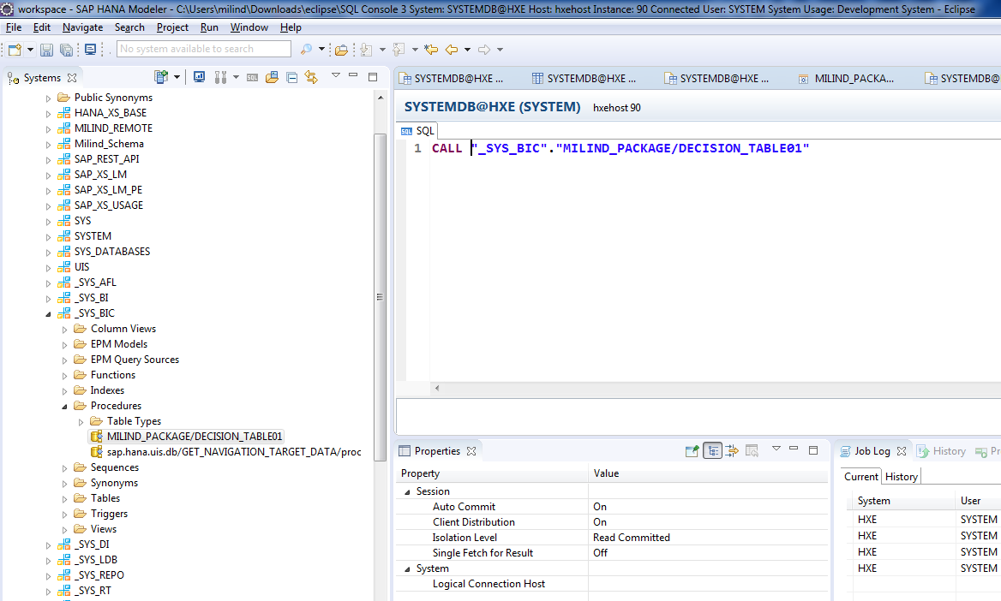
Go to _SYS_BIC schema.

Slide 12
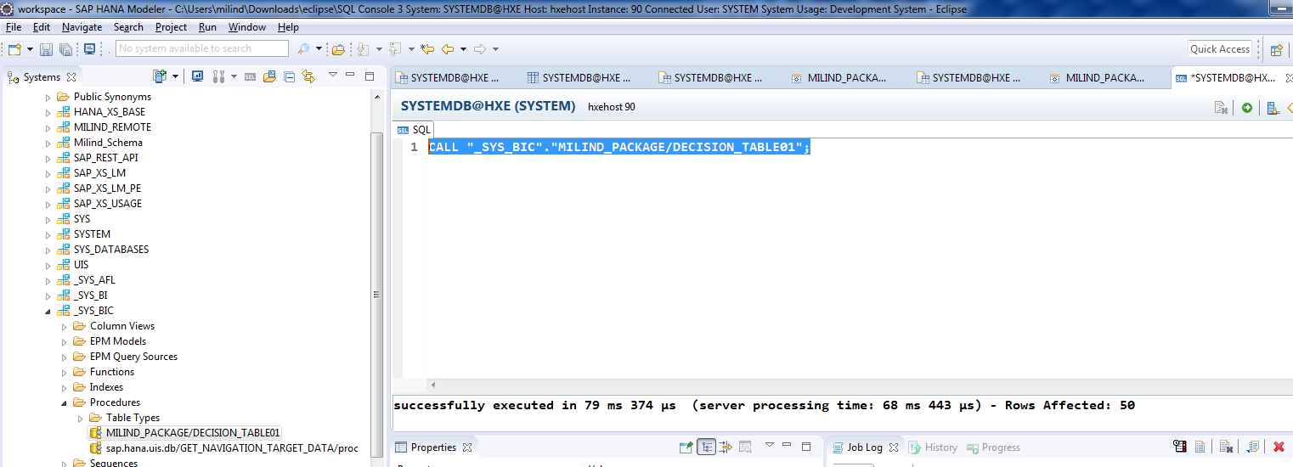
Cont.

Slide 13
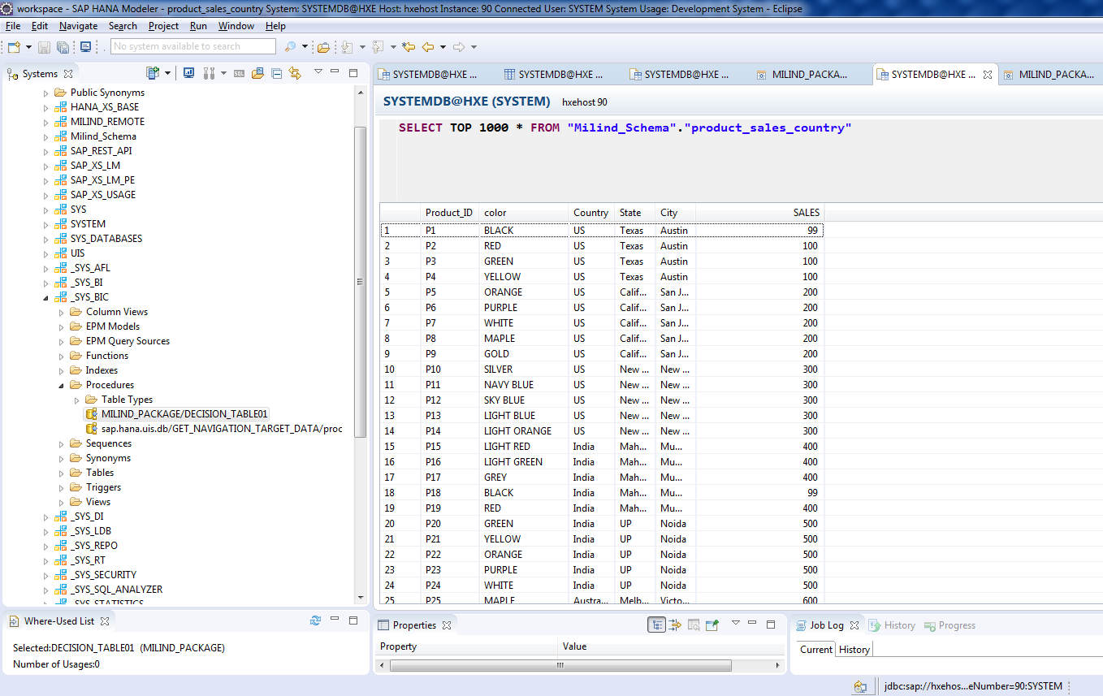
Check the values where color is Black.

